Slide 1

Entropy Inference and the James-Stein Estimator, with Application to Nonlinear Gene Association Networks

Slide 2
Entropy Estimation Methods
Shannon Entropy
Maximum Likelihood Estimator
Miller-Madow Estimator
Bayesian Estimators
Chao-Shen Estimator
Shrinkage Estimator

Slide 3

Simulation Results
Four scenarios tested:
Dirichlet with alpha = 0.0007
Dirichlet with alpha = 1
Dirichlet with half zeros
Zipf distribution
Metrics: MSE and Bias
Sample sizes: 10 to 10.000

Slide 4
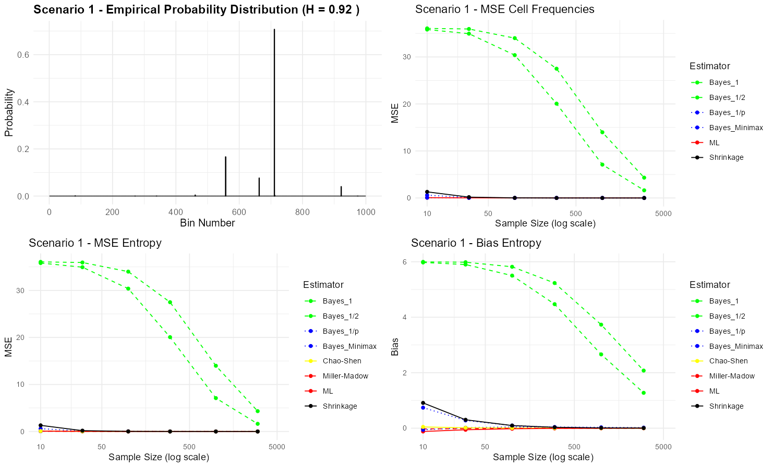
Simulation Results – Scenario 1 α = 0.0007

Slide 5
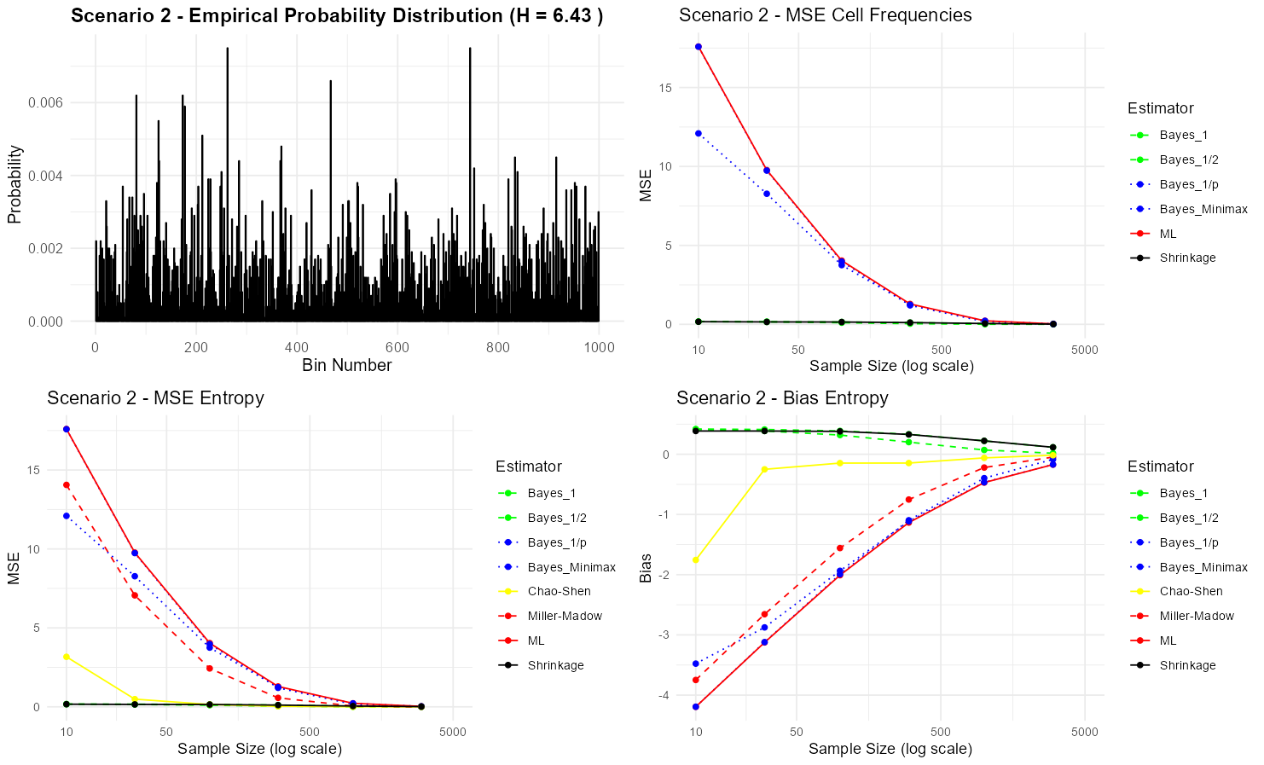
Simulation Results – Scenario 2 α = 1

Slide 6
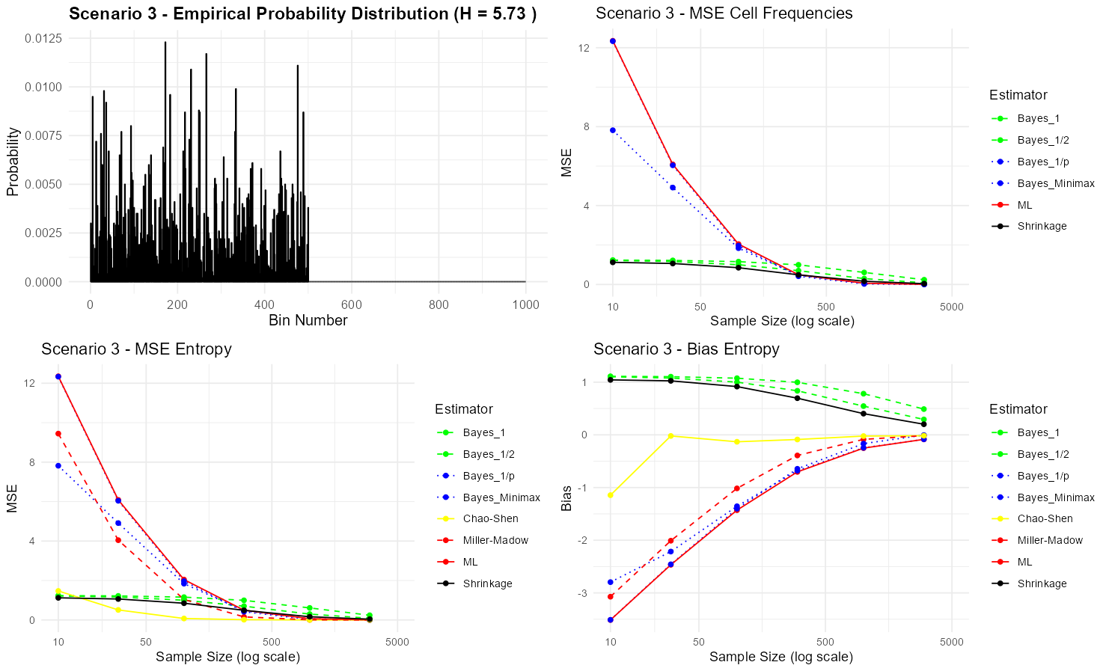
Simulation Results – Scenario 3 500 zeros

Slide 7
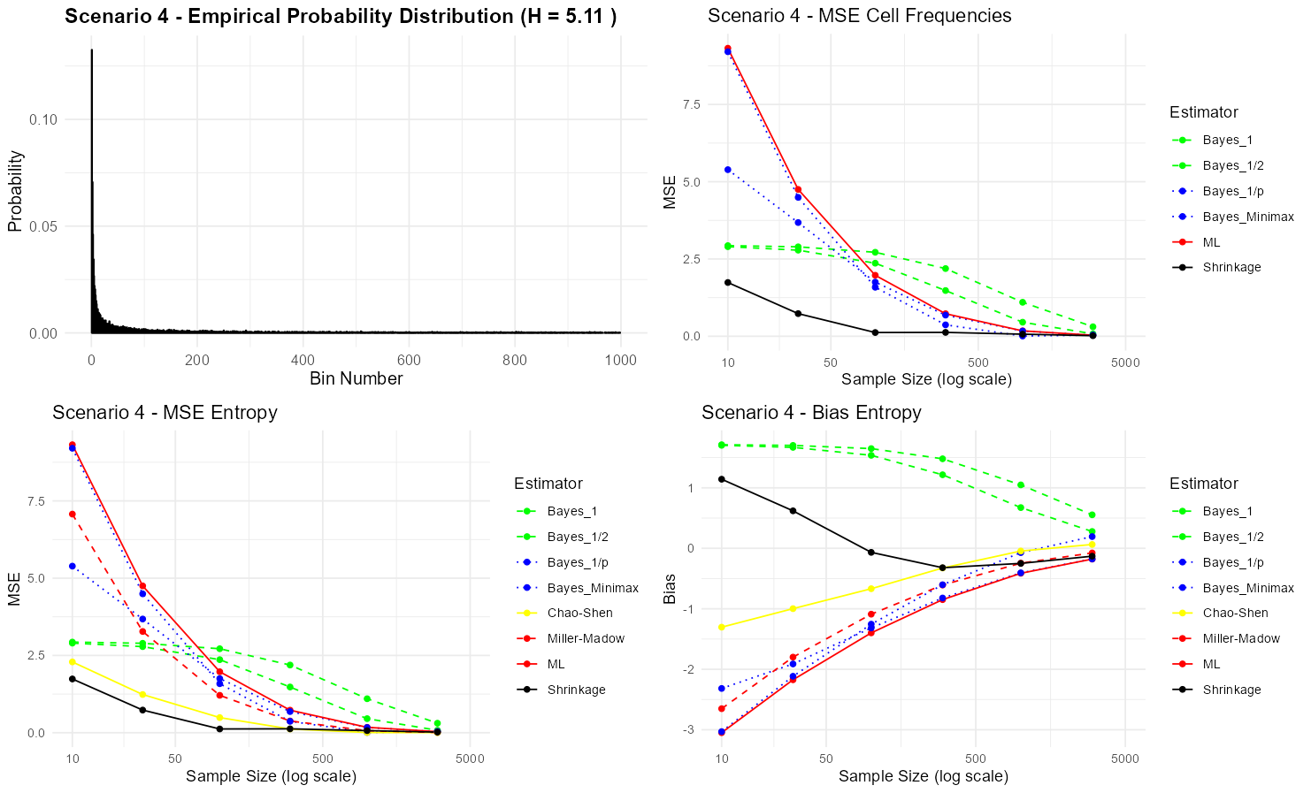
Simulation Results – Scenario 4 Zipf

Slide 8
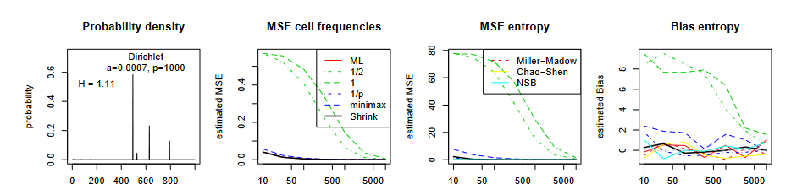
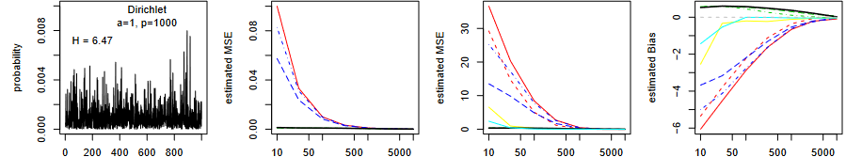
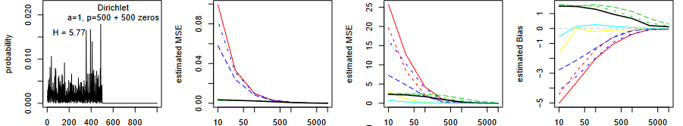
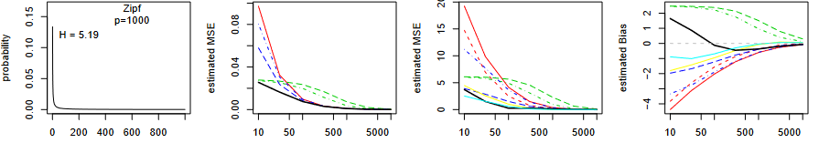
Simulations of the paper:
SCENARIO 1
SCENARIO 2
SCENARIO 3
SCENARIO 4

Slide 9
Mutual Information Calculation
Shrinkage entropy estimation
Discretization of data
Pairwise mutual information calculation

Slide 10
ARACNE Algorithm
Purpose:
Infer gene regulatory networks
Key steps:
1) Calculate mutual information for all gene pairs
2) Apply Data Processing Inequality to remove indirect interactions
3) Threshold to remove weak connections

Slide 11
E. coli Gene Network
Number of nodes: 85
Number of edges: 102
Top 5 hub genes:
ycgX ilvC hupB nuoL yjcH

Slide 12
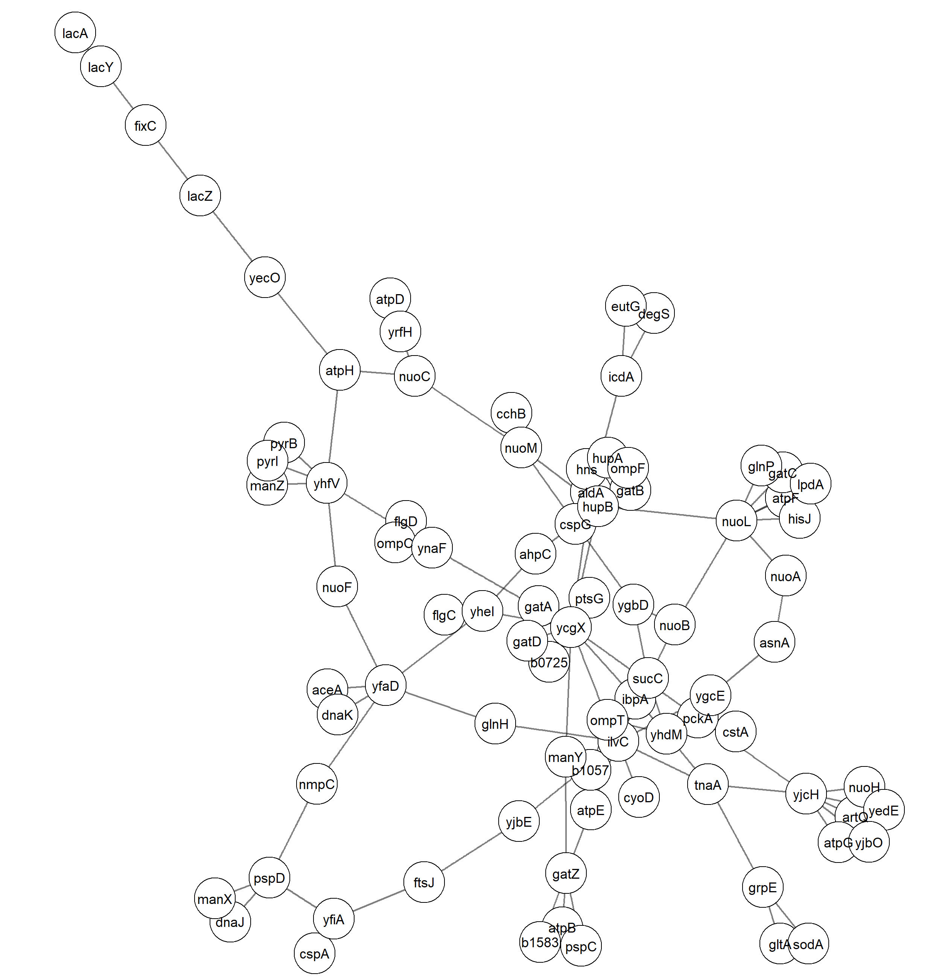
E. COLI GENE NETWORK

